Slide 1
Verilog Design Behavioral Modeling
EE417 Logic Design Using FPGAs

Slide 2
3. Behavioral Modeling
reg a, b, c
initial
begin
a = 1’b0;
c = 1’b1;
end
…
always @ ( sensitivity list)
begin
b = a^1’b1;
c = a + b;
end
The design is expressed in algorithmic level, which frees designers from thinking in terms of logic gates or data flow.
All algorithmic procedural statements in Verilog appear only inside two statements: always and initial
Each always and initial statement represents a separate activity flow in Verilog. The activity flows in Verilog run in parallel.
You can have multiple always and initial statements but you cannot nest them.

Slide 3
A Register
A reg is a Verilog variable type and does not necessarily imply a physical register. Think of it as a variable or place holder. It is unsigned by default.
reg clock;
reg [0:40] virtual_address;
Register arrays or memories are used to model register files, RAMs and ROMs.
reg mem1bit [0:1023]; //one-dimensional array of registers
reg [7:0] membyte [0:1023];
membyte [511];

Slide 4
Initial block:
reg x,y,m;
initial m = 1’b0;
Initial
begin
x = 1’b0;
y = 1’b1;
m = #10 1b’0;
end
An initial block starts at time 0, executes once and then is never used again.
If there are multiple initial blocks, they start to execute concurrently and they finish execution independently.
Multiple behavioral statements must be grouped using begin and end. If there is one statement then grouping is unnecessary.
In procedural statements (initial and always) LHS must be of type registers.

Slide 5
The always BLOCK
module mux2to1 (s,a,b,y);
input s,a,b;
output y;
reg y;
always @(a or b or s)
begin
y = (b&s) | (a & ~s);
end
endmodule
The always statement starts at time 0 and executes the statements in the always block when the events in its sensitivity list occur.
Powerful constructs like if, if-else, case, and looping are only allowed inside the always blocks.
Always statements can be used to implement both combinational and sequential logic.
Multiple behavioral statements must be grouped together using begin and end.
Multiple always statements can appear in a module.

Slide 6
SENSITIVITY LIST OF EVENTS:
An event is the change in the value on a register or a net. Events can be utilized to trigger the execution of a statement or a block of statements.
The @ symbol is used to specify the event control.
For combinational logic, any net that appears on the RHS of an = operator in the always block should be included in the event list.
For sequential logic, statements are executed on changes in signal value or at a positive (posedge) or negative (negedge) transition of the signal.

Slide 7
Always Statements
Any net that is assigned within an always block must be declared as a reg type; this does not imply that this net is driven by a register or sequential logic.
Verilog supports two types of assignments within the always blocks:
Blocking assignment: “=” operator.
Non-Blocking assignment: “<=” operator.

Slide 8
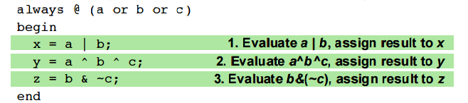
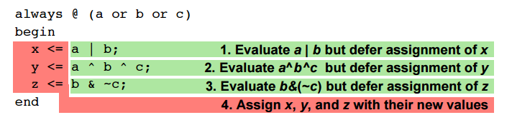
The order in which blocking assignments are written in an always block affects the logic that is synthesized
Blocking assignment = : Evaluation and assignment is immediate
Non-Blocking assignment <=:
all assignments are deferred until all expressions on the RHS have been evaluated
The order in which non-blocking assignments are written does not affect the logic that is synthesized as it is based on “old values” of the RHS registers

Slide 9
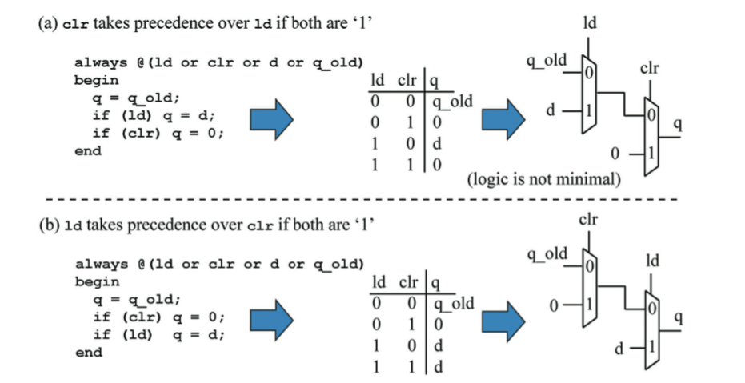
Because of the sequential nature of always blocks, the same net can be assigned multiple times in an always block; the last assignment takes precedence (as in HLL programming).

Slide 10
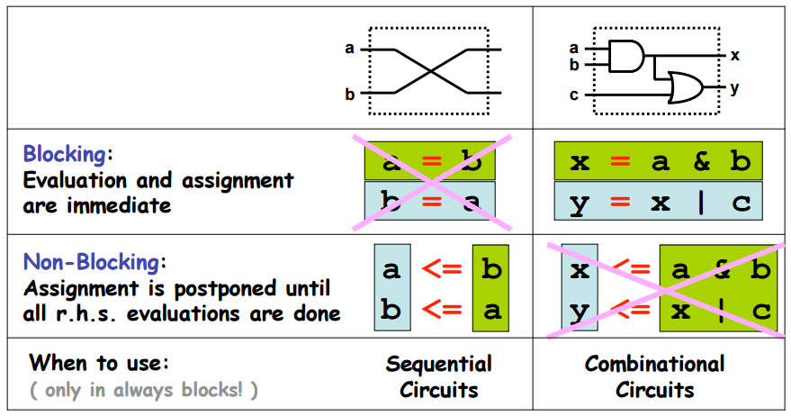
Conceptual need for the two kinds of assignments:
Race Condition

Slide 11
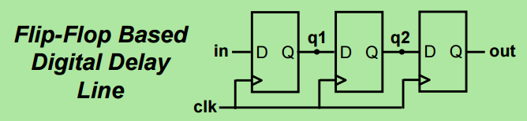
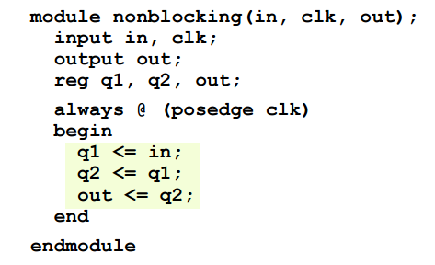
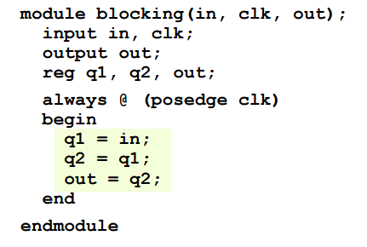
Assignments Styles for Sequential Logic
Will non-blocking and blocking assignments both produce the desired results?

Slide 12
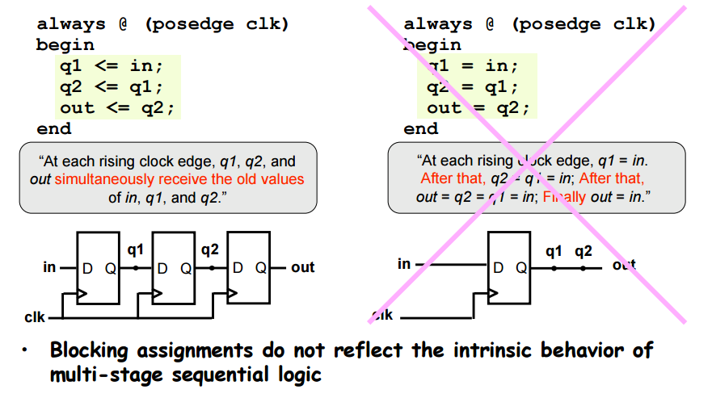
Use non-blocking assignments for sequential always blocks

Slide 13
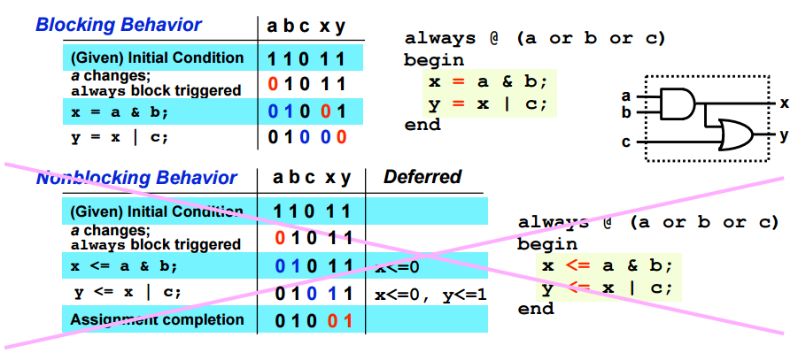
Use Blocking assignments for combinational logic

Slide 14
Conditional Statements: IF Statements
if(x)
begin
y = 1’b1;
z = 1’b0;
end
if(count <10)
count = count + 1;
else
count = 0;
If (alu_control == 0)
y = x+z;
else if (alu_control == 1)
y = x-z;
else if (alu_control == 2)
y = x*z;
else
y = x;

Slide 15
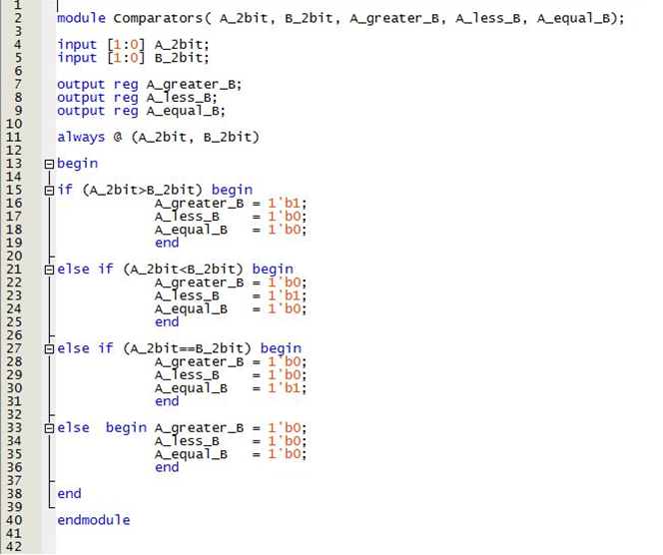

Slide 16
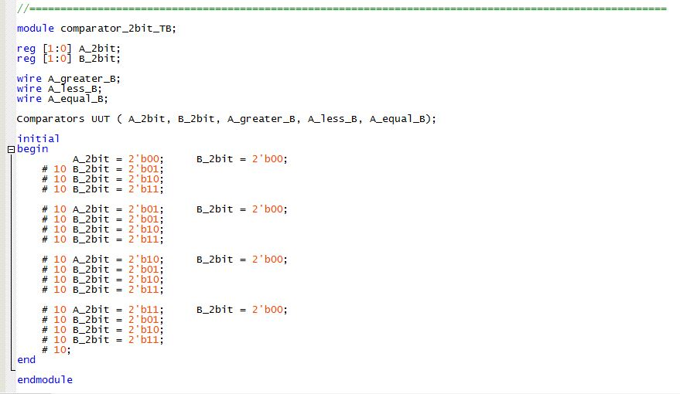

Slide 17
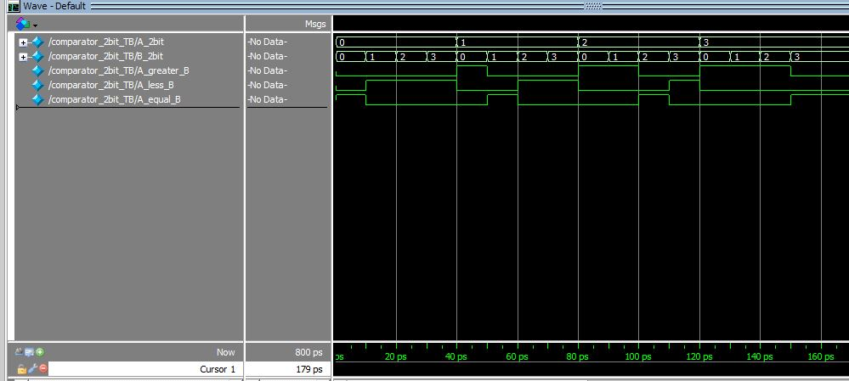

Slide 18
CONDITIONAL STAREMENTS: CASE STATEMENT
The case statement is used extensively for control flow and for finite state machines (FSM).
module mux4ch (output reg data, input [1:0] select, input a, b, c, d);
always@(a or b or c or d or select)
case (select)
0: data = a;
1: data = b;
2: data = c;
3: data = d;
default data = 1′bz;
endcase
endmodule
If there is some logic path through the always block that does not assign a value to the output net then a latch is inferred.

Slide 19
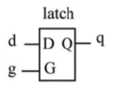
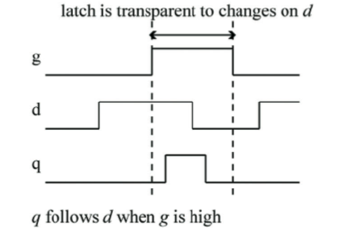
Level-Sensitive Latch: D-Latch
When the g input is zero, then the always block does not make any assignments to q, causing the synthesis tool to infer a latch on the q output as the q output must retain its last known d value when g was a ‘1’.
always @ (g or d)
begin
if (g) q <= d;
end

